Slide 1
Lagrangian Relaxation-1
CONTENTS:
Illustration using constrained shortest path
Bounding principle
Lagrangian Relaxation in a more general form
The Lagrangian Multiplier Problem
Lagrangian Relaxation and inequality constraints
READING ASSIGNMENTS:
Chap 16
Notes:
Obtain a network, and use the same network to illustrate the shortest path problem for communication networks, the max flow problem, the minimum cost flow problem, and the multicommodity flow problem. This will be a very efficient way of introducing the four problems. (Perhaps under 10 minutes of class time.)

Slide 2
On bounding in optimization
In solving network flow problems, we not only solve the problem, but we provide a guarantee that we solved the problem.
Guarantees are one of the major contributions of an optimization approach.
But what can we do if a minimization problem is too hard to solve to optimality?
Sometimes, the best we can do is to offer a lower bound on the best objective value. If the bound is close to the best solution found, it is almost as good as optimizing.

Slide 3
Overview
Decomposition based approach.
Start with
  Easy constraints
  Complicating Constraints.
Put the complicating constraints into the objective.
We will obtain a lower bound on the optimal solution for minimization problems.
In many situations, this bound is close to the optimal solution value.

Slide 4
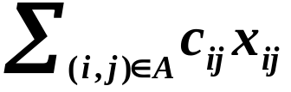
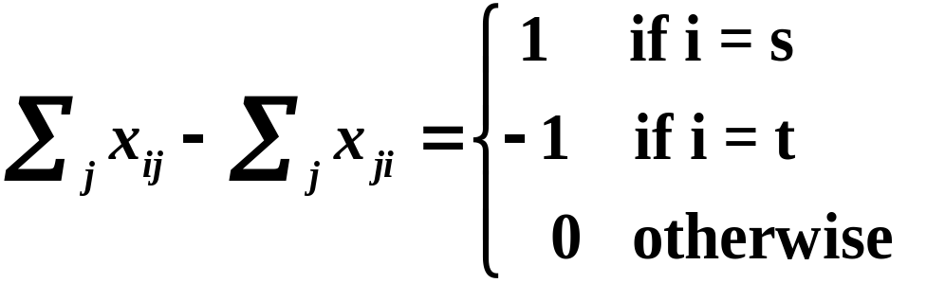
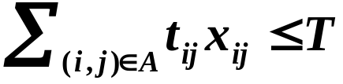

An Example: Constrained Shortest Paths
Given: a network G = (N,A)
c_{ij} cost for arc (i,j)
t_{ij} traversal time for arc (i,j)
Z* = Min
s. t.
Complicating constraint

Slide 5
Example
Find the shortest path from node 1 to node 6 with a transit time at most 10
(c_{ij},t_{ij})
i
j
2
(1,1)
4
(1,10)
(2,3)
(1,7)
1
(1,2)
(10,1)
6
(5,7)
(10,3)
(2,2)
3
5
(12,3)

Slide 6
Shortest Paths with Transit Time Restrictions
Shortest path problems are easy.
Shortest path problems with transit time restrictions are NP-hard.
We say that constrained optimization problem Y is a relaxation of problem X if Y is obtained from X by eliminating one or more constraints.
We will “relax” the complicating constraint, and then use a “heuristic” of penalizing too much transit time. We will then connect it to the theory of Lagrangian relaxations.

Slide 7
Shortest Paths with Transit Time Restrictions
Step 1. (A relaxation approach). Solve the problem without the complicating constraint.
If the solution satisfies the complicating constraint, then it is optimal for the original problem.

Slide 8
What is the shortest path from node 1 to node 6?
2
(1,1)
4
(1,10)
(2,3)
(1,7)
1
(1,2)
(10,1)
6
(5,7)
(10,3)
(2,2)
3
5
(12,3)

Slide 9
The shortest path is 1-2-4-6
The transit time of
1-2-4-6 is 18.
To reduce the transit time of the shortest path, we put a penalty proportional to transit time.
2
(1,1)
4
(1,10)
(2,3)
(1,7)
1
(1,2)
(10,1)
6
(5,7)
(10,3)
(2,2)
Suppose that we charge a toll of $1 per unit transit time.
3
5
(12,3)

Slide 10
What is the new shortest path from 1 to 6?
The modified cost of 1-2-5-6 is 20. The transit time is 15. The cost is 5.
2
2
4
11
5
8
1
11
6
3
12
1-2-5-6 is still not feasible.
13
4
3
5
15
We increase the toll to $2

Slide 11
What is the new shortest path from 1 to 6?
The path 1-2-5-6 is still an optimal path.
However, its transit time is still 15>10 which is still infeasible.
What to do?
Find an alternative shortest path
2
3
4
21
8
15
1
12
6
5
19
16
6
3
5
18

Slide 12
And there is an alternative shortest path.
The modified costs of 1-2-5-6 is 35.
2
3
4
1-3-2-5-6 is also optimal
And it is optimal for the original problem as well!
21
8
15
1
12
6
5
19
16
6
3
5
The transit time of 1-3-2-5-6 is 10. The cost is 15.
18

Slide 13
A parametric analysis
Toll | Weighted Sum | Cost | Transit Time | Weighted Sum - 10 * Toll
0 | 3 | 3 | 18 | 3
1 | 20 | 5 | 15 | 10
2 | 35 | 15 | 10 | 15
3 | 45 | 15 | 10 | 15
4 | 55 | 15 | 10 | 15
5 | 64 | 24 | 8 | 14
6 | 72 | 24 | 8 | 12
7 | 80 | 24 | 8 | 10
8 | 88 | 24 | 8 | 8
9 | 96 | 24 | 8 | 6
10 | 104 | 24 | 8 | 4

Slide 14
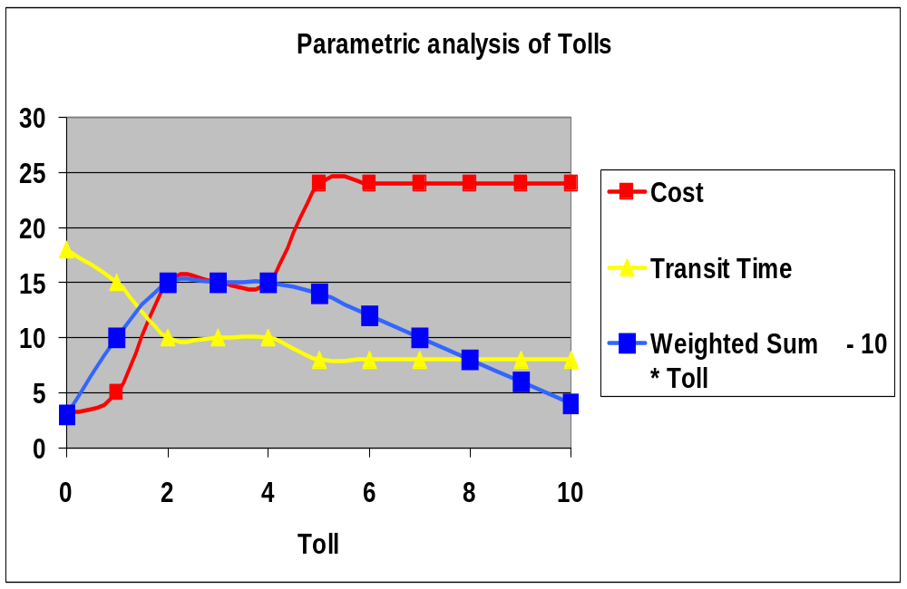

Slide 15
On Bounding
We could charge any non-negative toll on μ transit times.
For a path P, let c_{P} = ∑_{(i,j)∈P} c_{ij}
t_{P} = ∑_{(i,j)∈P} t_{ij}
For fixed μ and P, let c_{P}(μ) = ∑_{(i,j)∈P} [c_{ij} + μ t_{ij}]
Bounding Principle. Suppose that μ ≥ 0 and that P is the minimum cost path with respect to modified costs c_{P}(μ). Then c_{P}(μ) - μ T is a lower bound on the length of the constrained shortest path.

Slide 16
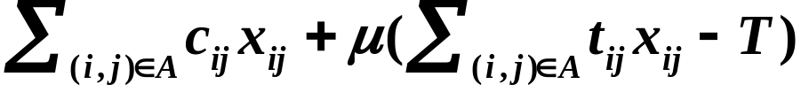
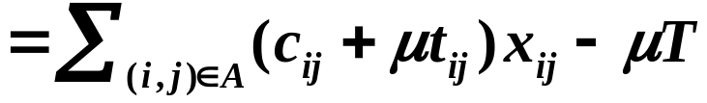
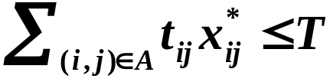
Towards the Lagrangian Relaxation
z* = min
s.t.
For each μ ≥ 0, replace the objective by:
z(μ) = min
Then z(μ) ≤ z* for μ ≥ 0 because

Slide 17
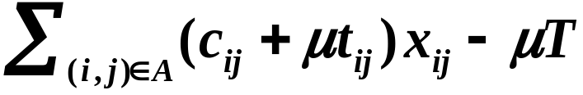
The Lagrangian Relaxation
L(μ) = min
s.t.
The Lagrangian relaxation was obtained by penalizing the constraint and then eliminating (relaxing) the constraint.
Theorem. L(μ) ≤ z(μ) ≤ z*
z(μ) still keep the constraint, but L(μ) does not

Slide 18


Application to constrained shortest path
L(μ) = min
Let c(P) be the cost of path P
Let be the modified cost of path P
Corollary. Suppose P* is a shortest path for the problem with modified costs, and suppose
Then P* is optimal.
Proof:

Slide 19



The Lagrangian Relaxation Technique
s.t.
P
P(μ)
s.t.
Lemma 16.1. For all vectors μ, L(μ) ≤ z*.
(since x* is feasible for P(μ))

Slide 20

The Lagrangian Multiplier Problem
(with equality constraints)
P(μ)
s.t.
Lemma 16.1. For all vectors μ, L(μ) ≤ z*.
A bound for a minimization problem is better if it is higher. The problem of finding the best bound is called the Lagrangian multiplier problem.
Lemma 16.2. For all vectors μ, L(μ) ≤ L* ≤ z*.

Slide 21
The Optimality Test
Property 16.3 (Optimality test). If L(μ) = L* = z* = cx, then x is optimal for the original problem, and μ is optimal for the Lagrangian multiplier problem.
More typically, a Lagrangian bound is useful when it shows that a solution is close to being optimal.

Slide 22
Summary
Each solution value L(μ) is a lower bound on the optimum objective value.
L* is the best (highest) lower bound.
If L(μ) = cx, then L* = z* = cx.
(This is not guaranteed to happen.)
L* (or some good lower bound) is useful in heuristics and in branch and bound.
Sometimes it can be used to give a short proof of optimality.

Slide 23
Lagrangian Relaxation and Inequality Constraints
z* = Min cx
subject to Ax ≤ b, (P≤)
x ∈ X.
L(μ) = Min cx + μ(Ax - b) (P≤(μ))
subject to x ∈ X,
Lemma. L(μ) ≤ z* for μ ≥ 0.
The Lagrange Multiplier Problem: maximize (L(μ) : μ ≥ 0).
Suppose L* denotes the optimal objective value, and suppose x is feasible for P≤ and μ ≥ 0. Then L(μ) ≤ L* ≤ z* ≤ cx.

Slide 24
Generalized assignment problem ex. 16.8 Ross and Soland [1975]
1
a_{ij} = the amount of
processing time of
job i on machine j
1
2
2
x_{ij} = 1 if job i is processed
on machine j
= 0 otherwise
3
3
4
4
Job i gets processed.
5
Machine j has at most d_{j} units of processing
Set I of jobs
Set J of machines

Slide 25
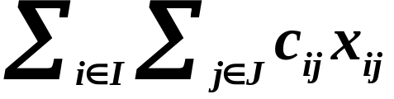
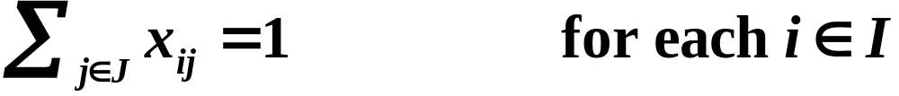
Generalized assignment problem ex. 16.8 Ross and Soland [1975]
Minimize
(16.10a)
(16.10b)
(16.10c)
(16.10d)
Generalized flow with integer constraints.
Class exercise: write two different Lagrangian relaxations.

Slide 26
Facility Location Problem ex. 16.9 Erlenkotter 1978
Consider a set J of potential facilities
Opening facility j ∈ J incurs a cost F_{j}.
The capacity of facility j is K_{j}.
Consider a set I of customers that must be served
The total demand of customer i is d_{i}.
Serving one unit of customer i’s from location j
costs c_{ij}.
customer
potential facility

Slide 27
A pictorial representation

Slide 28
A possible solution

Slide 29
Class Exercise
Formulate the facility location problem as an integer program. Assume that a customer can be served by more than one facility.
Suggest a way that Lagrangian Relaxation can be used to help solve this problem.
Let x_{ij} be the amount of demand of customer i served by facility j.
Let y_{j} be 1 if facility j is opened, and 0 otherwise.

Slide 30
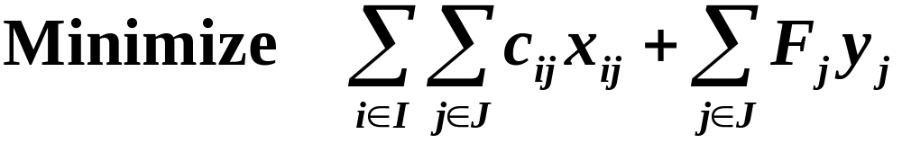
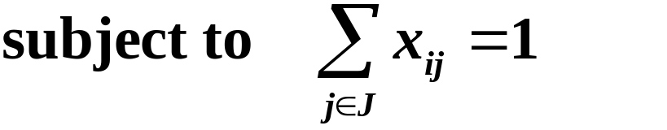

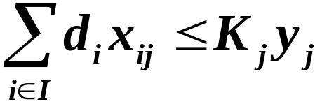

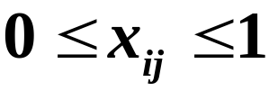

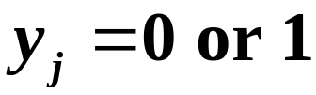
The facility location model

Slide 31
Summary of the Lecture
Lagrangian Relaxation
  Illustration using constrained shortest path
  Bounding principle
  Lagrangian Relaxation in a more general form
  The Lagrangian Multiplier Problem
  Lagrangian Relaxation and inequality constraints
  Very popular approach when relaxing some constraints makes the problem easy
Applications
  TSP
  Generalized assignment
  Facility Location

Slide 32
Next Lecture
Review of Lagrangian Relaxation
Lagrangian Relaxation for Linear Programs
Solving the Lagrangian Multiplier Problem
  Dantzig-Wolfe decomposition

